Slide 1
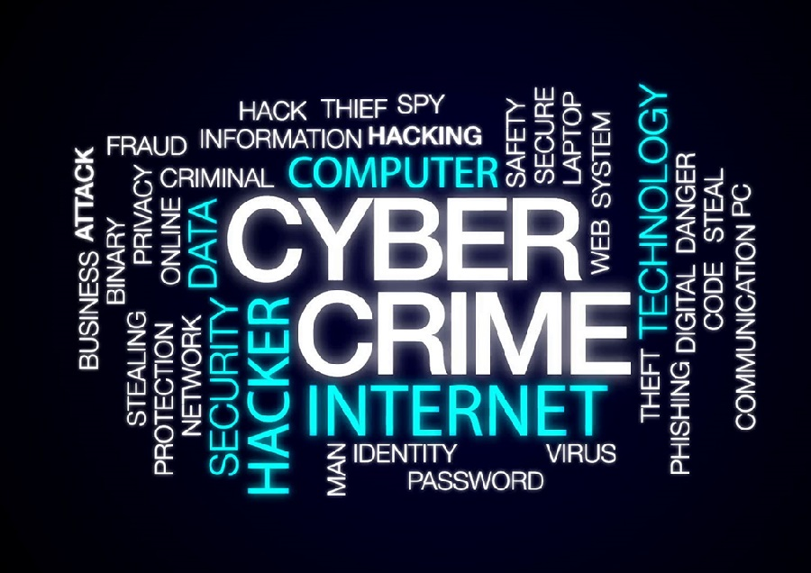
Cyber Security
Awareness Program
RSWM-KGM
Pawan Kumar Jain
Date:04-07-2022

Slide 2
  Security awareness training is a formal process for educating employees and third-party stakeholders, like contractors and business partners, how to protect an organization's computer systems, along with its data, people and other assets, from internet-based threats or criminals.
  Cyber criminals take advantage of your trust, fear and greed.
  Security awareness training teaches you to spot fakes, avoid risks online, and use good cyber-hygiene practices at work and at home.
What is Cyber
Security
Awareness Training ?

Slide 3

We are in increasing digital world
      Banking
      Shopping
      Healthcare
      Business
      Digital Social Platform
We are in
Digital
World

Slide 4
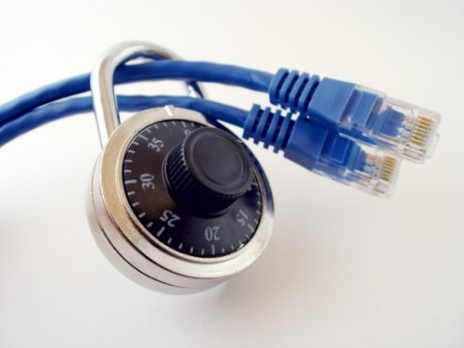
The internet allows an attacker to work from anywhere on the planet.
Risks caused by poor security knowledge and practice:
  Identity Theft
  Monetary Theft
  Legal Ramifications (for yourself and your organization)
  Sanctions or termination if policies are not followed
According to the SANS Institute, the top vectors for vulnerabilities available to a cyber criminal are:
  Web Browser
  IM Clients
  Web Applications
  Excessive User Rights
Importance of Cybersecurity

Slide 5

Cyber-Criminals
System Administrators
Some scripts appear useful
to manage networks…
Cracker:
Computer-savvy
programmer creates
attack software
User Awareness
Posts to
Hacker Bulletin Board
SQL Injection
Buffer overflow
Password Crackers
Password Dictionaries
Successful attacks!
Crazyman broke into …
CoolCat penetrated…
Script Kiddies:
Unsophisticated computer users who know how to
execute programs
Downloads
Reports
Posts to
Criminals: Create & sell bots -> generate spam
Sell credit card numbers, etc…
Malware package earns $1K-2K
1 M Email addresses earn $8
10,000 PCs earn $1000
5

Slide 6


Viruses
Worms
Trojan Horses / Logic Bombs
Social Engineering
Rootkits
Botnets / Zombies
Leading Threats

Slide 7
Program
A
A virus attaches itself to a program, file, or disk.
When the program is executed, the virus activates and replicates itself.
The virus may be benign or malignant but executes its payload at some point (often upon contact).
  Viruses can cause computer crashes and loss of data.
In order to recover or prevent virus attacks:
  Avoid potentially unreliable websites/emails.
  System Restore.
  Re-install operating system.
  Use and maintain anti-virus software.
Viruses
Extra Code
infects
Program
B

Slide 8
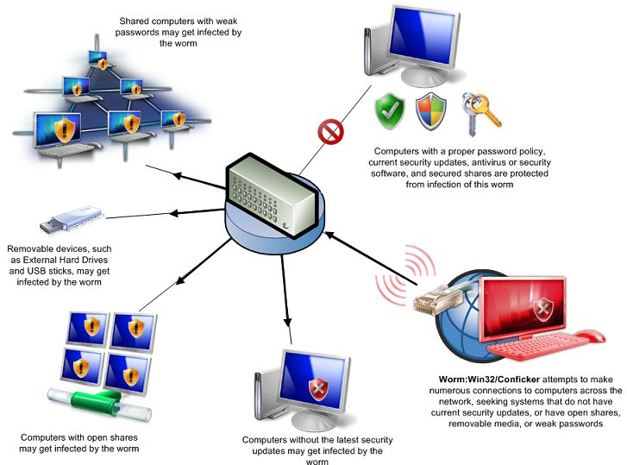
Independent program that replicates itself and sends copies from computer to computer across network connections.
Upon arrival, the worm may be activated to replicate.
Worms
To Joe
To Ann
To Bob
Email List:
Joe@gmail.com
Ann@yahoo.com
Bob@u.edu

Slide 9
Logic Bomb: Malware logic executes upon certain conditions. The program is often used for otherwise legitimate reasons.
  Examples:
  Software which malfunctions if maintenance fee is not paid.
  Employee triggers a database erase when he is fired.
Trojan Horse: Masquerades as a benign program while quietly destroying data or damaging your system.
  Download a game: It may be fun but contains hidden code that gathers personal information without your knowledge.
Logic Bombs and Trojan Horses

Slide 10


Social engineering manipulates people into performing actions or divulging confidential information. Similar to a confidence trick or simple fraud, the term applies to the use of deception to gain information, commit fraud, or access computer systems.
Social Engineering
Email:
ABC Bank has
noticed a
problem with
your account…
Phone Call:
This is John, the System Administrator. What is your password?
In Person:
What ethnicity are you? Your mother’s maiden name?
I have come to repair your machine…
and have some lovely software patches!

Slide 11
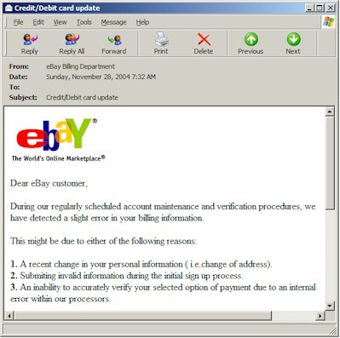
Phishing: A seemingly trustworthy entity asks for sensitive information such as SSN, credit card numbers, login IDs or passwords via e-mail.
Phishing: Counterfeit Email

Slide 12
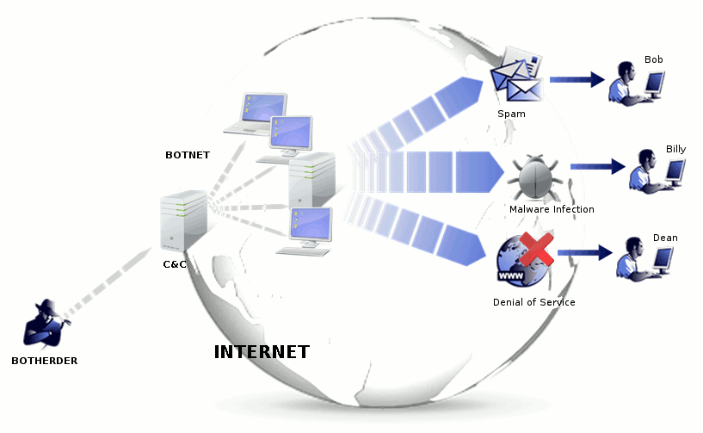
A botnet is a number of compromised computers used to create and send spam or viruses or flood a network with messages as a denial of service attack.
The compromised computers are called zombies.
Botnet

Slide 13
Upon penetrating a computer,
a hacker may install a collection
of programs, called a rootkit.
May enable:
  Easy access for the hacker (and others)
  into the enterprise
  Keystroke logger
Eliminates evidence of break-in.
Modifies the operating system.
Rootkit
Backdoor entry
Keystroke Logger
Hidden user

Slide 14

Symptoms:
  Antivirus software detects a problem.
  Disk space disappears unexpectedly.
  Pop-ups suddenly appear, sometimes selling security software.
  Files or transactions appear that should not be there.
  The computer slows down to a crawl.
  Unusual messages, sounds, or displays on your monitor.
  Stolen laptop: 1 stolen every 53 seconds; 97% never recovered.
  The mouse pointer moves by itself.
  The computer spontaneously shuts down or reboots.
  Often unrecognized or ignored problems.
Identifying Security Compromises

Slide 15
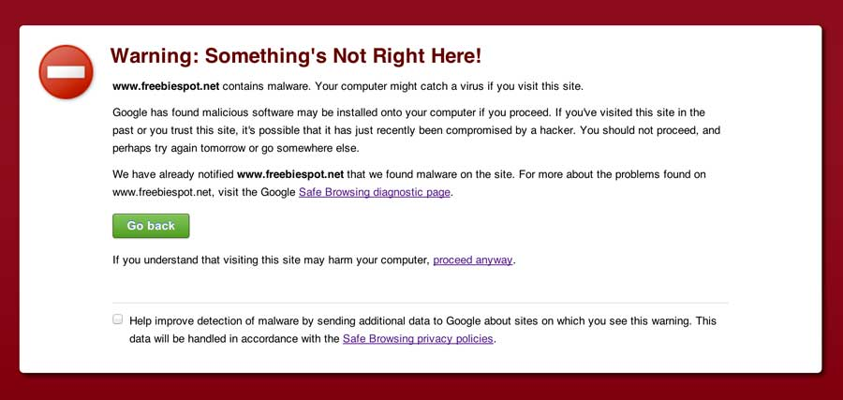
Spyware symptoms:
  Changes to your browser homepage/start page.
  Ending up on a strange site when conducting a search.
  System-based firewall is turned off automatically.
  Lots of network activity while not particularly active.
  Excessive pop-up windows.
  New icons, programs, favorites which you did not add.
  Frequent firewall alerts about unknown programs when trying to access the Internet.
  Poor system performance.
Malware detection

Slide 16
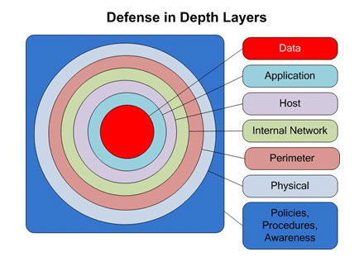
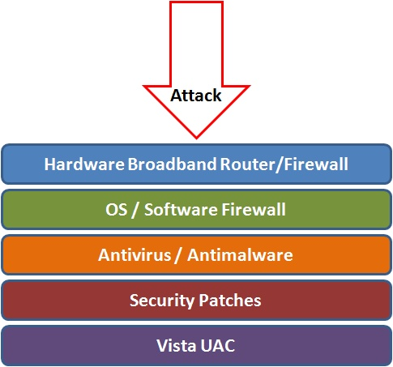
Defense in depth uses multiple layers of defense to address technical, personnel and operational issues.
Best Practices to avoid these threats

Slide 17
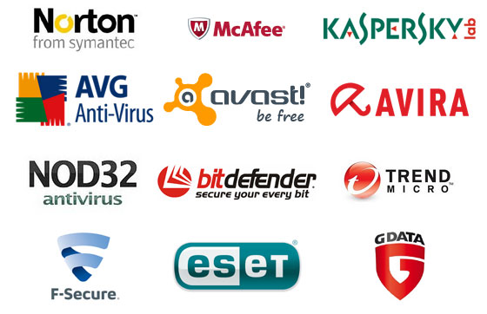
Anti-virus software detects certain types of malware and can destroy it before any damage is done.
Install and maintain anti-virus and anti-spyware software.
Be sure to keep anti-virus software updated.
Many free and commercial options exist.
Contact your Technology Support Professional for assistance.
Anti-virus and Anti-spyware Software

Slide 18
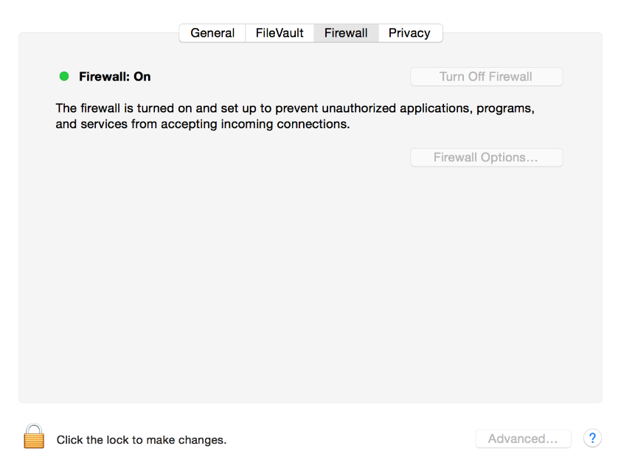
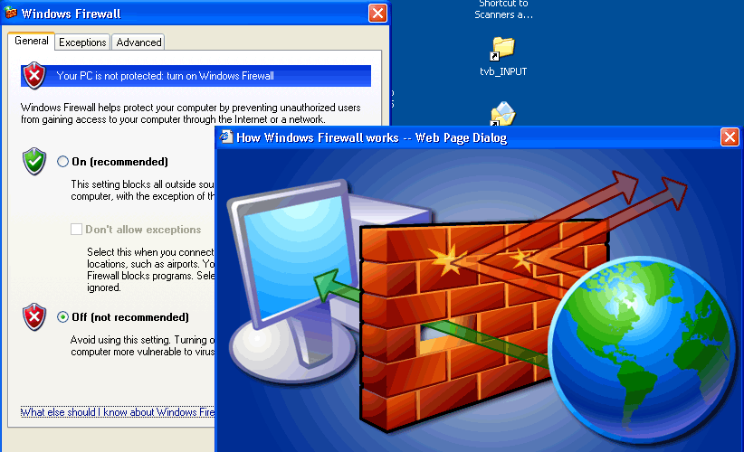
A firewall acts as a barrier between your computer/private network and the internet. Hackers may use the internet to find, use, and install applications on your computer. A firewall prevents many hacker connections to your computer.
Firewalls filter network packets that enter or leave your computer
Host-based Firewalls

Slide 19

Do not open email attachments unless you are expecting the email with the attachment and you trust the sender.
Do not click on links in emails unless you are absolutely sure of their validity.
Only visit and/or download software from web pages you trust.
Avoid Social Engineering
and Malicious Software

Slide 20

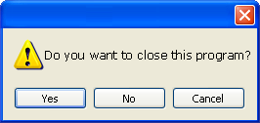
Be sure to have a good firewall or pop-up blocker installed.
Pop-up blockers do not always block ALL pop-ups so always close a pop-up window using the ‘X’ in the upper corner.
Never click “yes,” “accept” or even “cancel.”
Infected USB drives are often left unattended by hackers in public places.
Avoid Stupid Hacker Tricks

Slide 21
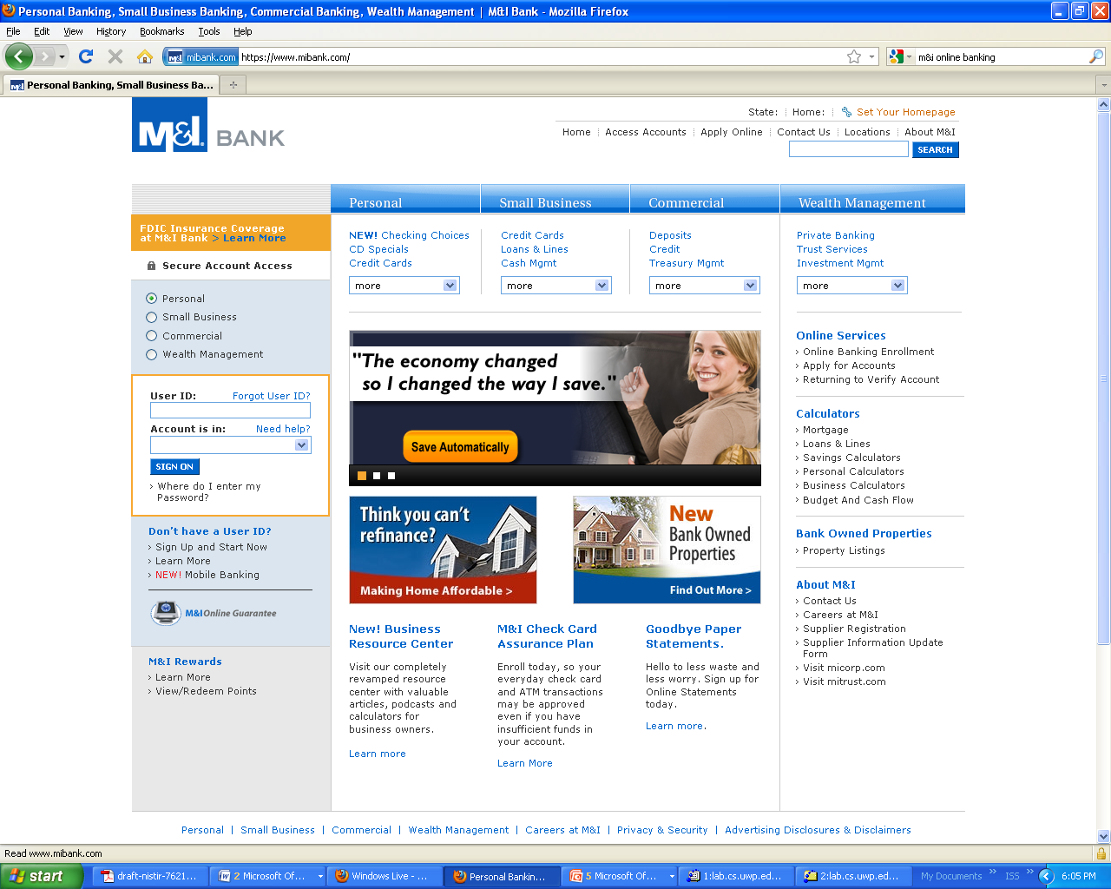
Always use secure browser to do online activities.
Frequently delete temp files, cookies, history, saved passwords etc.
Secure Business Transactions
https://
Symbol indicating
enhanced security

Slide 22

Backup Important Information
No security measure is 100% reliable.
Even the best hardware fails.
What information is important to you?
Is your backup:
    Recent?
    Off-site & Secure?
    Process Documented?
    Encrypted?
    Tested?

Slide 23


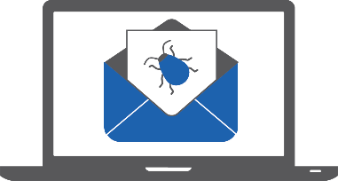

In each 50 Websites 1 is malicious
Is Online Transactions are safe?
To appear authentic 1 in every 3 phishing sites uses HTTPS
90% of malware that businesses come is delivered via email.
The majority of data thefts include phishing and the use of stolen credentials.

Slide 24
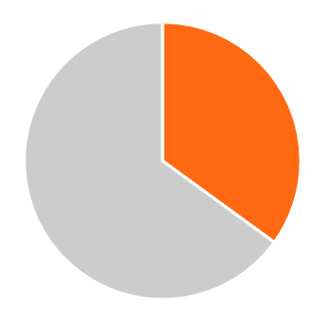
35%
49%
Facts which we should know
Employees who know they’ve been hacked don’t bother to change their passwords afterward
Employees admit they click links in messages from unknown senders during work
67%
40%
Employees are sure they’ve received at least one phishing email at work
Employees who received a phishing email, 40% didn’t report it

Slide 25
How can people get benefit from Security Awareness Training?
At Home
At Work
Protect your identity and personal data from theft and fraud
Secure your devices against
viruses and malware
Keep yourself and your family safe from hackers and spies
Prevent corporate network infections
Stop business email compromise
Keep critical business data safe

Slide 26
Benefits Of Security Awareness Training For Businesses
How can Business get benefit from Security Awareness Training?
Develop a security-focused culture.
Empower employees.
Protect assets.
Prevent downtime.
Increase adoption.
Institute proactive practices.
Collect risk data by driving awareness.
Get everyone on the same page.

Slide 27
Internet
Firewall Cycle in RSWM
JIO (50MB)
BSNL(20MB)
Firewall
Switch
Internet Access -> Don’t Allow Unauthorised User to access Internet
Unwanted Website -> Won’t allow to access Unwanted websites

Slide 28
THANK YOU

